Slide 1


CITS1003 Introduction to Cybersecurity [6] Security Management exercises
Dr Zhi Zhang

Slide 2
Security Assessment
Attack Tree
Threat Modelling
Project Overview

Slide 3
What is security assessment:
It is a process of evaluating the information-security posture of an organization’s information systems
Its objective is to identify weaknesses that can be addressed and thus enhance the overall security
e.g., Network Security Assessment including firewall configuration, email channels, intrusion detection deployment

Slide 4

Attack Tree
https://www.youtube.com/watch?v=rGljOEqLrjQ

Slide 5
Attack Tree
What is an attack tree?
It is a graphical structure of different paths that an attacker can take to achieve a specific attack goal.
It is used to identify potential weaknesses within a system and develop strategies to mitigate those weaknesses.

Slide 6
Attack Tree
An attack tree has:
root node describes the goal of an attack
child node represents a sub-goal or an attack step for the overall goal
leaf node refers to an attack step and has no child node

Slide 7
Attack Tree
1 disable a web server
1.1 conduct a DDoS attack against the server
1.2 remotely shutdown the server
1.2.1 brute force the server's login credentials to gain an unauthorized access

Slide 8
Attack Tree
An attack tree has:
root node is the overall goal of the attack
child node represents a sub-goal or an attack step for the overall goal
leaf node refers to an attack step and has no child node
logical gate denotes the relationship among child nodes
OR gates: completing only one child node can lead to the completion of a parent node
AND gates:

Slide 9
Attack Tree
1 steal valuable items from a jewelry store
1.1 smash the display case and grab items
1.2 force a store employee to open the display case

Slide 10
Attack Tree
An attack tree has:
root node is the overall goal of the attack
child node represents a sub-goal or an attack step for the overall goal
leaf node refers to an attack step and has no child node
logical gate denotes the relationship among different nodes
OR gates: completing only one child node can lead to the completion of a parent node
AND gates: completing all child nodes so that a parent node can succeed

Slide 11
Attack Tree
1 gain an unauthorized access to a secure building
1.1 obtain a valid access card
1.2 steal the door passcode

Slide 12
Exercise
1. gain an access to a target user’s private information
1.1 gain an access to a target user database
1.1.1 exploit a software vulnerability in the system
1.2 log in as a target user
1.2.1 brute-force login
1.2.1.1 search a target username
1.2.1.2 search a target user password
1.2.2 steal user private credentials
1.3 hijack user session
1.3.1 steal user session cookie
OR
OR
AND

Slide 13
Exercise
1. gain an access to a target user’s private information
1.1 gain an access to a target user database
1.1.1 exploit a software vulnerability in the system
1.2 log in as a target user
1.2.1 brute-force login
1.2.1.1 search a target username
1.2.1.2 search a target user password
1.2.2 steal user private credentials
1.3 hijack user session
1.3.1 steal user session cookie
OR
OR
AND

Slide 14
1 gain an access to a user’s private information
1.1 gain direct access to the database
1.2 login as a target user
1.3 hijack user session

Slide 15
Exercise
1. gain an access to a target user’s private information
1.1 gain an access to a target user database
1.1.1 exploit a software vulnerability in the system
1.2 log in as a target user
1.2.1 brute-force login
1.2.1.1 identify a target username
1.2.1.2 identify a target user password
1.2.2 steal user private credentials
1.3 hijack user session
1.3.1 steal user session cookie
OR
OR
AND

Slide 16
1 gain an access to a user’s private information
1.1 gain direct access to the database
1.2 login as a target user
1.3 hijack user session
1.1.1 exploit a software vulnerability in the system
1.2.1 brute-force login
1.2.2 steal user private credentials
1.3.1 steal user session cookie

Slide 17
Exercise
1. gain an access to a target user’s private information
1.1 gain an access to a target user database
1.1.1 exploit a software vulnerability in the system
1.2 log in as a target user
1.2.1 brute-force login
1.2.1.1 identify a target username
1.2.1.2 identify a target user password
1.2.2 steal user private credentials
1.3 hijack user session
1.3.1 steal user session cookie
OR
OR
AND

Slide 18
1 gain an access to a user’s private information
1.1 gain direct access to the database
1.2 login as target user
1.3 hijack user session
1.1.1 exploit a software vulnerability in the system
1.2.1 brute-force login
1.2.2 steal user private credentials
1.3.1 steal user session cookie
1.2.1.1 identify a target username
1.2.1.2 identify a target user password

Slide 19
root node
1 gain an access to a user’s private information
1.1 gain direct access to the database
1.2 Login as target user
1.3 Hijack user session
1.1.1 exploit a software vulnerability in the system
1.2.1 brute-force login
1.2.2 steal user private credentials
1.3.1 Steal user session cookie
1.2.1.1 identify a target username
1.2.1.2 identify a target user password

Slide 20
root node
1 gain an access to a user’s private information
1.1 gain direct access to the database
1.2 Login as target user
1.3 Hijack user session
1.1.1 exploit a software vulnerability in the system
1.2.1 brute-force login
1.2.2 steal user private credentials
1.3.1 Steal user session cookie
1.2.1.1 identify a target username
1.2.1.2 identify a target user password
leaf node
leaf node

Slide 21
Attack Tree
How to evaluate the impact of an attack goal?
assign each leaf node a value and calculate the value for the root node
common practices for the assignment
probability of success represents the likelihood that a leaf node can be completed (e.g., 0 or 100%)
cost represents the resources required to complete a leaf node (e.g., low, medium and high)

Slide 22
Possible or Impossible?
?
1 gain an access to a user’s private information
level-1
?
?
?
level-2
1.1 gain direct access to the database
1.2 login as a target user
1.3 hijack user session
level-3
I
?
P
I
1.1.1 exploit a software vulnerability in the system
1.2.1 brute-force login
1.2.2 steal user private credentials
1.3.1 steal user session cookie
P
I
1.2.1.1 identify a target username
1.2.1.2 identify a target user password
level-4

Slide 23
?
1 gain an access to a user’s private information
level-1
?
?
?
level-2
1.1 gain direct access to the database
1.2 login as a target user
1.3 hijack user session
level-3
I
I
P
I
1.1.1 exploit a software vulnerability in the system
1.2.1 brute-force login
1.2.2 steal user private credentials
1.3.1 Steal user session cookie
P
I
1.2.1.1 identify a target username
1.2.1.2 identify a target user password
level-4

Slide 24
?
1 gain an access to a user’s private information
level-1
I
?
?
level-2
1.1 gain direct access to the database
1.2 login as a target user
1.3 hijack user session
level-3
I
I
P
I
1.1.1 exploit a software vulnerability in the system
1.2.1 brute-force login
1.2.2 steal user private credentials
1.3.1 steal user session cookie
P
I
1.2.1.1 identify a target username
1.2.1.2 identify a target user password
level-4

Slide 25
?
1 gain an access to a user’s private information
level-1
I
?
I
level-2
1.1 gain direct access to the database
1.2 login as a target user
1.3 hijack user session
level-3
I
I
P
I
1.1.1 exploit a software vulnerability in the system
1.2.1 brute-force login
1.2.2 steal user private credentials
1.3.1 steal user session cookie
P
I
1.2.1.1 identify a target username
1.2.1.2 identify a target user password
level-4

Slide 26
?
1 gain an access to a user’s private information
level-1
I
P
I
level-2
1.1 gain direct access to the database
1.2 login as a target user
1.3 hijack user session
level-3
I
I
P
I
1.1.1 exploit a software vulnerability in the system
1.2.1 brute-force login
1.2.2 steal user private credentials
1.3.1 steal user session cookie
P
I
1.2.1.1 identify a target username
1.2.1.2 identify a target user password
level-4

Slide 27
P
1 gain an access to a user’s private information
level-1
I
P
I
level-2
1.1 gain direct access to the database
1.2 login as a target user
1.3 hijack user session
level-3
I
I
P
I
1.1.1 exploit a software vulnerability in the system
1.2.1 brute-force login
1.2.2 steal user private credentials
1.3.1 steal user session cookie
P
I
1.2.1.1 identify a target username
1.2.1.2 identify a target user password
level-4

Slide 28
Calculate attack cost?
?
1 gain an access to a user’s private information
level-1
?
?
?
1.1 gain direct access to the database
1.2 login as target user
1.3 hijack user session
level-2
$200
?
$400
$50
1.1.1 exploit a software vulnerability in the system
1.2.1 brute-force login
1.2.2 steal user private credentials
1.3.1 steal user session cookie
level-3
$5
$50
1.2.1.1 identify a target username
1.2.1.2 identify a target user password
level-4

Slide 29
?
1 gain an access to a user’s private information
level-1
?
?
?
1.1 gain direct access to the database
1.2 login as target user
1.3 hijack user session
level-2
$200
55
$400
$50
1.1.1 exploit a software vulnerability in the system
1.2.1 brute-force login
1.2.2 steal user private credentials
1.3.1 steal user session cookie
level-3
$5
$50
1.2.1.1 identify a target username
1.2.1.2 identify a target user password
level-4

Slide 30
?
1 gain an access to a user’s private information
level-1
$200
?
?
1.1 gain direct access to the database
1.2 login as a target user
1.3 hijack user session
level-2
$200
55
$400
$50
1.1.1 exploit a software vulnerability in the system
1.2.1 brute-force login
1.2.2 steal user private credentials
1.3.1 steal user session cookie
level-3
$5
$50
1.2.1.1 identify a target username
1.2.1.2 identify a target user password
level-4

Slide 31
?
1. gain an access to a user’s private information
level-1
$200
?
$50
1.1. gain direct access to the database
1.2. login as a target user
1.3. hijack user session
level-2
$200
$55
$400
$50
1.1.1. exploit a software vulnerability in the system
1.2.1. brute-force login
1.2.2. steal user private credentials
1.3.1. steal user session cookie
level-3
$5
$50
1.2.1.1. identify a target username
1.2.1.2. identify a target user password
level-4

Slide 32
?
1. gain an access to a user’s private information
level-1
$200
$55
$50
1.1. gain direct access to the database
1.2. login as a target user
1.3. hijack user session
level-2
$200
$55
$400
$50
1.1.1. exploit a software vulnerability in the system
1.2.1. brute-force login
1.2.2. steal user private credentials
1.3.1. steal user session cookie
level-3
$5
$50
1.2.1.1. identify a target username
1.2.1.2. identify a target user password
level-4

Slide 33
$50
1. gain an access to a user’s private information
level-1
$200
$55
$50
1.1. gain direct access to the database
1.2. Login as target user
1.3. Hijack user session
level-2
$200
$55
$400
$50
1.1.1. exploit a software vulnerability in the system
1.2.1. brute-force login
1.2.2. steal user private credentials
1.3.1. Steal user session cookie
level-3
$5
$50
1.2.1.1. identify a target username
1.2.1.2. identify a target user password
level-4

Slide 34
Exercise
Given this scenario
A malicious student wants to tamper the final grade on csmarks. There is only one database storing all data for csmarks, which includes student ids, student names, grades etc.
The grades are automatically pulled from LMS at midnight everyday, and thus a teaching staff only uploads student marks onto LMS. Also, the staff can override the marks by editing on csmarks directly. To login to csmarks or LMS, the staff uses the PHEME password.
Identify the overall attack goal
Draw an attack tree of at most 6 nodes to achieve the goal

Slide 35
Given this scenario
A malicious student wants to tamper the final grade on csmarks. There is only one database storing all data for csmarks, which includes student ids, student names, grades etc.
The grades are automatically pulled from LMS at midnight everyday, and thus a teaching staff only uploads student marks onto LMS. Also, the staff can override the marks by editing on csmarks directly. To login to csmarks or LMS, the staff uses the PHEME password.
Identify the overall attack goal
Draw an attack tree of at most 6 nodes to achieve the goal

Slide 36
Given this scenario
A malicious student wants to tamper the final grade on csmarks. There is only one database storing all data for csmarks, which includes student ids, student names, grades etc.
The grades are automatically pulled from LMS at midnight everyday, and thus a teaching staff only uploads student marks onto LMS. Also, the staff can override the marks by editing on csmarks directly. To login to csmarks or LMS, the staff uses the PHEME password.
Identify the overall attack goal
Draw an attack tree of at most 6 nodes to achieve the goal

Slide 37
1 an adversary gains an edit-access to final grades

Slide 38
Given this scenario
A malicious student wants to tamper the final grade on csmarks. There is only one database storing all data for csmarks, which includes student ids, student names, grades etc.
The grades are automatically pulled from LMS at midnight everyday, and thus a teaching staff only uploads student marks onto LMS. Also, the staff can override the marks by editing on csmarks directly. To login to csmarks or LMS, the staff uses the PHEME password.
Identify the overall attack goal
Draw an attack tree of at most 6 nodes to achieve the goal

Slide 39
1 an adversary gains an edit-access to final grades
1.1 login to csmarks as target staff
1.2 login to LMS as
target staff

Slide 40
Given this scenario
A malicious student wants to tamper the final grade on csmarks. There is only one database storing all data for csmarks, which includes student ids, student names, grades etc.
The grades are automatically pulled from LMS at midnight everyday, and thus a teaching staff only uploads student marks onto LMS. Also, the staff can override the marks by editing on csmarks directly. To login to csmarks or LMS, the staff uses the PHEME password.
Identify the overall attack goal
Draw an attack tree of at most 6 nodes to achieve the goal

Slide 41
1. an adversary gains an edit-access to final grades
1.1. login to csmarks as target staff
1.2. login to LMS as
target staff
1.1.1. steal PHEME password and username
1.2.1. steal user session cookie

Slide 42
Threat Modelling
What is threat modelling:
It is a structured approach to create a security model of a given system
It is used to identify, assess, and prioritize potential threats to an organization’s information systems

Slide 43
Threat Modelling
Compare threat modelling with attack tree?

Slide 44
Threat Modelling
Compare threat modelling with attack tree?
e.g., similarity: both are valuable for security assessment and can be used in combination to provide a comprehensive understanding of potential security threats to an information system.

Slide 45
Threat Modelling
Compare threat modelling with attack tree?
e.g., similarity: both are valuable for security assessment and can be used in combination to provide a comprehensive understanding of potential security threats to an information system.
difference: threat modeling is a broader approach that evaluates potential weaknesses to an information system as a whole.
attack tree is a more focused approach that analyzes a specific attack scenario and the possible attack steps to achieve a specific attack goal.

Slide 46
Threat Modelling
What is threat modelling:
It is a structured approach to create a security model of a given system
A representative methodology: STRIDE
Demo: MS Threat Modelling Tool (based on STRIDE)

Slide 47
STRIDE
What is STRIDE?
It is a threat modelling methodology used to identify and categorize all potential threats to an information system.
STRIDE stands for Spoofing, Tampering, Repudiation, Information disclosure, Denial of service, and Elevation of privilege.

Slide 48
STRIDE
Category | Description
Spoofing | An attacker impersonates a targeted user to gain unauthorized access to a system.
Tampering | An attacker modifies data or code to change the behavior of a software/system.
Repudiation | An attacker denies their actions or the actions of others on the system.

Slide 49
STRIDE
Category | Description
Spoofing | An attacker impersonates a targeted user to gain unauthorized access to a system.
Tampering | An attacker modifies data or code to change the behavior of a software/system.
Repudiation | An attacker denies their actions or the actions of others on the system.
Information Disclosure | An attacker accesses unauthorized sensitive information.
Denial of Service | An attacker prevents legitimate users from accessing a target system or performing actions on the system.
Elevation of Privilege | An attacker gains higher-privilege access to a target system than they are authorized to have.

Slide 50
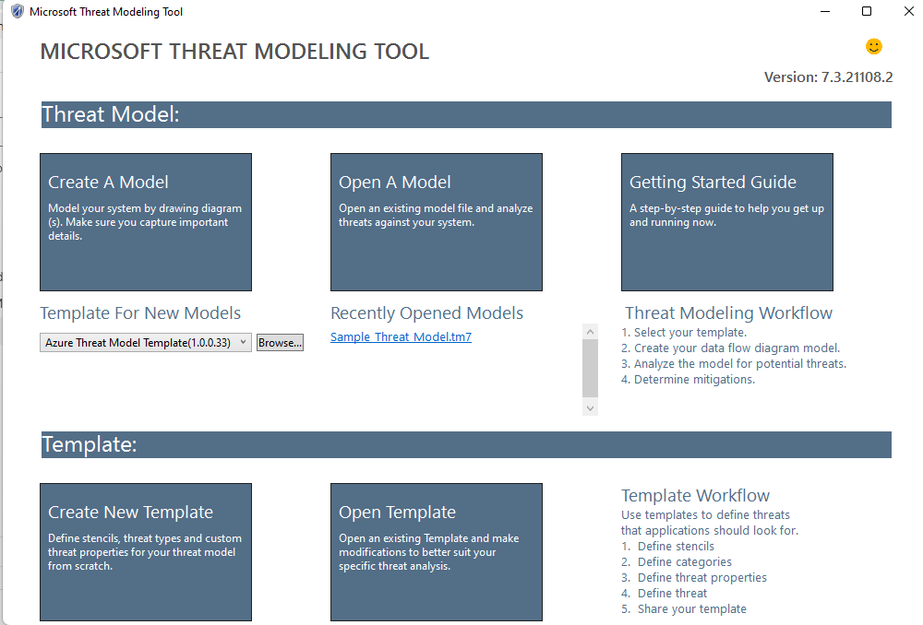
MS Threat Modelling Tool
MS TMT only supports windows OS
https://docs.microsoft.com/en-gb/azure/security/develop/threat-modeling-tool-getting-started

Slide 51
Demo
Given this scenario
Alice opens a browser to login to a web server via her own credentials.
The web server will authenticate Alice by validating her username and password via its SQL database.
Draw a diagram using MS TMT

Slide 52
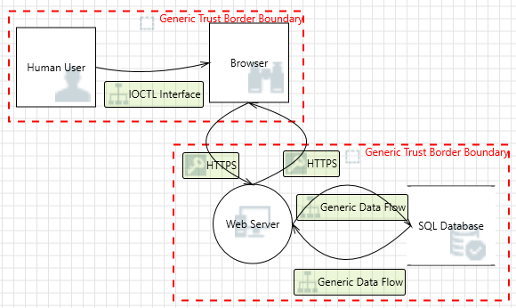
Demo

Slide 53
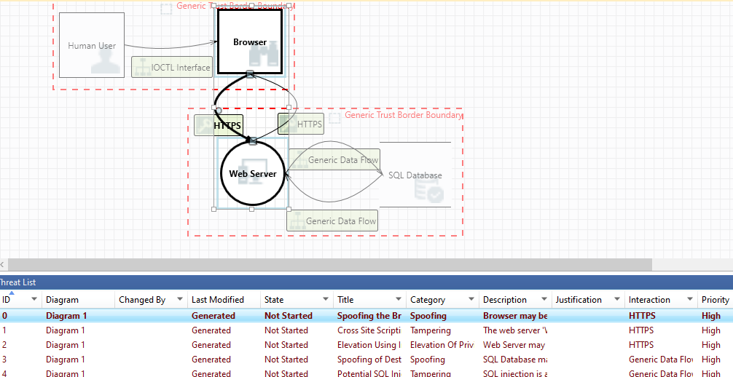
Demo

Slide 54
Demo
Draw this diagram

Slide 55
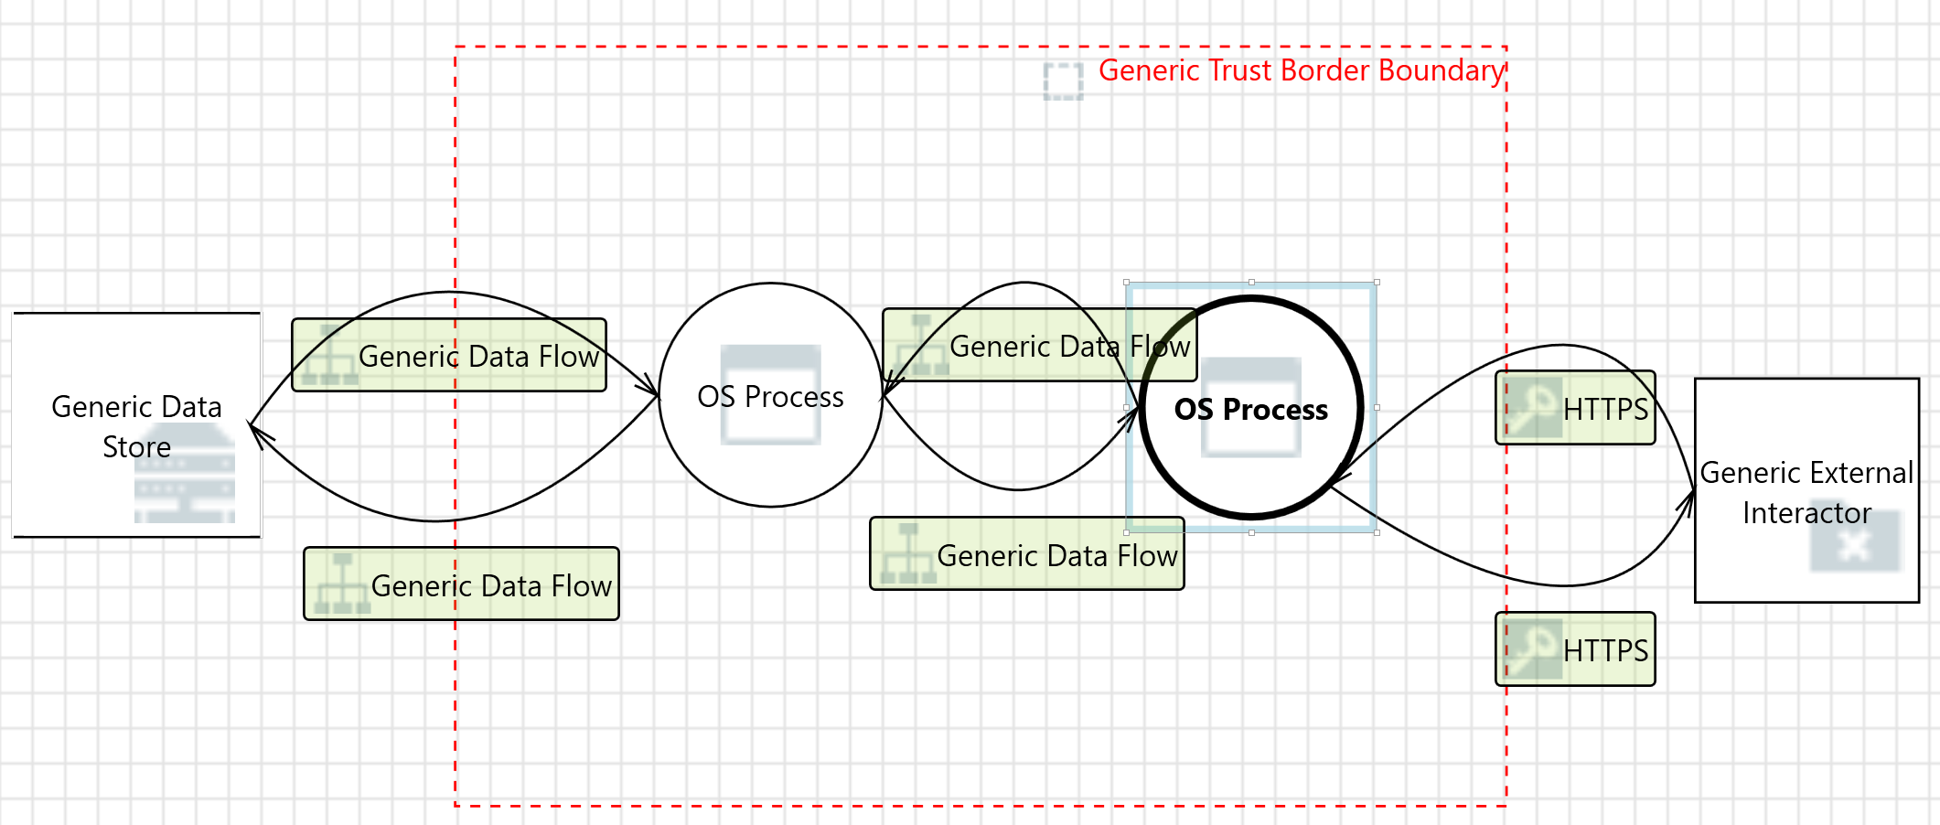
Exercise
Given this diagram

Slide 56
Exercise
Given this diagram

Slide 57
Exercise
Given this diagram
web application
browser

Slide 58
Exercise
Given this diagram
local SQL database
web application
browser

Slide 59
Exercise
Given this diagram
SQL backup database
local SQL database
web application
browser

Slide 60
Exercise
A possible scenario:
Alice opens a browser to login to a web server via her own credentials.
The web server will validate Alice by checking if her username and password are stored in its local SQL database.
When Alice updates her personal information, the local SQL database interacts with the SQL backup database to synchronize the updates.

Slide 61
Threat Modelling
If there are multiple threats with the same severity in a threat model, which one should be addressed first?
Is using a threat model such as MS TMT sufficient for securing a system?

Slide 62
Threat Modelling
If there are multiple threats with the same severity in a threat model, which one should be addressed first?
An example answer:
It is important to prioritize the threats with the same-level severity based on some critical factors
e.g., probability of occurrence, potential impact, ease of mitigation, available resources, and compliance requirements

Slide 63
Threat Modelling
Probability of occurrence:
Rank the likelihood of each threat that can actually occur, as some threats may be more likely to occur than others.
Potential impact:
Rank the potential impact of each threat as some threats may have a higher potential impact than others.

Slide 64
Threat Modelling
Ease of mitigation:
Rank how easy it would be to mitigate each threat, as some threats may be easier to address while others may require more efforts and resources.
Compliance requirements:
Rank threats based on whether addressing each of them can comply with regulatory or industry requirements, as some threats may be more important to address to comply with regulations or industry standards.

Slide 65
Threat Modelling
Is using a threat model such as MS TMT sufficient for securing a system?

Slide 66
Threat Modelling
Is using a threat model such as MS TMT sufficient for securing a system?
e.g., it should be used in conjunction with other security measures, such as access control, monitoring, and applying security patches.

Slide 67
Project
Availability
https://labs.cits1003.jinhong.org
Project Details
https://uwacyber.gitbook.io/cits1003/cits1003-project/overview

